Slide 1

ConfigMgr 2012 r2 OSD Tips and Tricks
Presenter - Fred Bainbridge
@FredBainbridge

Slide 2
Operating System deployment
Overview
Tips and Tricks
Gotchyas

Slide 3
OSD Overview

Slide 4
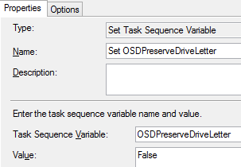
OSD Tips and Tricks
House Keeping
Consistency is key!
Verbose Logging is very helpful. Use a structured naming convention.
Wrapper scripts will help.
Uniform folders.
SMSTSDownloadRetryDelay = 300
OSDPreserveDriveLetter = False
New in 2012 R2
Increase the SMSTS.log size!
Technet Blog Link
Boundary Groups, Certificates, Boot Media, Drivers, etc….
Access Content Directly from DP? Or download locally?

Slide 5
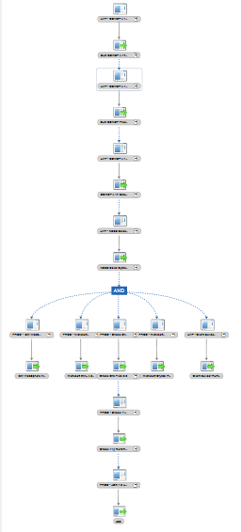
OSD Tips and Tricks
Applications
Know your exit codes!
0 and 3010 are most common. But be prepared for a wildcard.
The Application Model –
Keep it simple!
Be prepared to break it down.
Package vs. Application
(Use the Application, duh.)
Supersedence
Understand exactly how it works or don’t use it.

Slide 6
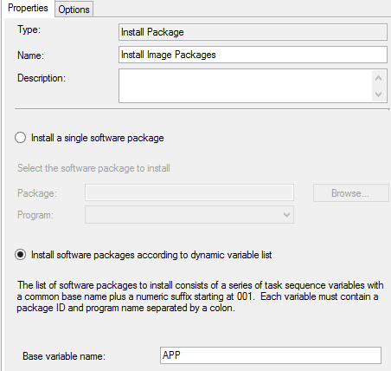
OSD Tips and Tricks
Image File (.WIM)
You need a new one. Trust me.
Use an automated build and capture
Collection Variables + PowerShell is your friend.
Things to put in your WIM
VC Runtimes
.NET
Windows Updates
Corporate Tagging
CMTRACE!

Slide 7
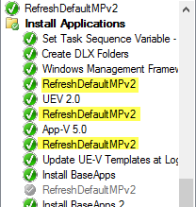
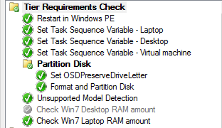
OSD Gotchyas
Know when reboots are happening!
Run an MP refresh script after each reboot. (Provided by Microsoft)
“Waiting for ccmexec service to start….”
App Model Dependency reboots must be avoided. (break up the app model)
Make sure problems are not external.
Networking? Bandwidth?
Have an update to date WIM
CCMExec service issues? Update to CU3
http://support.microsoft.com/kb/2994331 Client - The SMS Agent Host service may quit unexpectedly during the processing of task sequences.
Know your client log files. App*.log specifically.
Build error checking into your Task Sequence. (Utilize WMI)
Get statistically significant data.

Slide 8

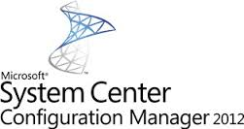


Questions?
Fred Bainbridge
fred@mnscug.org
@FredBainbridge

