Slide 1

Carlos Capó
Master Macs in Business
Easily integrate Macs into a Microsoft Shop
Sr. Manager
Global Business Solutions
ccapo@parallels.com

Slide 2
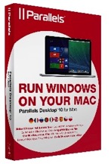





Leader in Cloud Services Enablement and Desktop Virtualization
Strong Foundation
900+ employees worldwide
100+ patents granted or pending
200+ partnerships include Microsoft, Apple, Intel and Symantec
Profitable and growing
Cloud Services
Cross Platform
Serving 9,000+ service providers and 10+ million small businesses (SMBs) in 130+ countries
5+ million units of Parallels Desktop for Mac sold worldwide
#1-selling Mac desktop virtualization software*
Self-Service Control Panels
Provisioning
Billing
Server Virtualization
*NPD Techworld Reports 8/1/06-12/31/12

Slide 3
Macs in Business Today
71%
of organizations
are currently
utilizing Macs
Notes:
So…let’s talk a little bit about the state of Apple in the Workplace. After years of grief for IT pros in all kinds of organizations, Apple acceptance has begun. We’ve all heard the recent news about Apple’s partnership with IBM. But ever before this, a large majority of companies had come to terms with the new enterprise IT paradigm – some industries led the way like education and healthcare and others were pulled along kicking and screaming.
Because we focus 100% on Macs, we regularly survey IT Admins to check in on what going on in their world.
In recent a poll of over 700 IT pros, we learned that nearly ¾ of those surveyed said they are currently utilizing Macs either as part of a formal BYOD program or a corporate initiative. POLL: Let’s see how that number compares with all of you. How many of you have Macs in their network?

Slide 4
Parallels Solutions for Business

Slide 5




PARALLELS SOLUTIONS FOR BUSINESS
DESKTOP
MANAGEMENT
Enables the Microsoft stack on Macs
Simplify administration & mass deployment
Configurable, policy-compliant solution
Business class support
Enables Mac management in SCCM 2012 and SCCM 2007
Seamless Mac Management, using existing tools, process and people
Manage and deploy Parallels Desktop and its virtual machines

Slide 6
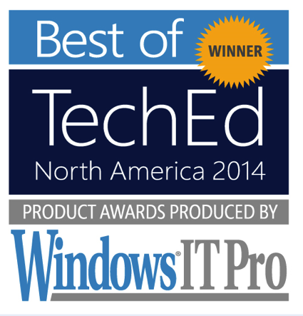
Parallels® Mac Management for
Microsoft System Center Configuration Manager
Notes:
Now let’s talk about managing those Macs. This past Spring, we attended the TechEd 2014 conference in Houston. We met over 500 IT pros and talked to them about Mac management. What’s even more exciting, Parallels Mac Management for Microsoft SCCM won the Best of TechEd award in the management systems category. POLL: of those of you allowing Macs today, how many of you are managing Macs?
In our survey, we asked how many organizations are currently using a centralized management system for the Macs in their environment. An alarming 82% said “no”. So think about this for a moment. Whether there are 50 Macs or 500, that represents fairly high security risk to any organization. As Microsoft System Center users, the ability to manage Macs the same way you do PCs will be the key to helping you get a handle on the Macs in your network. In fact, over 60% of those we surveyed were at least moderately interesting in the ability to manage both PCs and Macs using one centralized system.

Slide 7
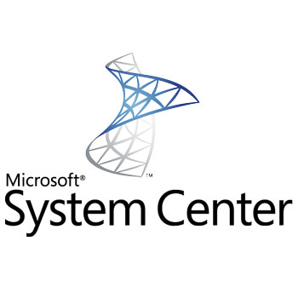
Today System Center is prevalent for PC management
Microsoft System Center Configuration Manager (SCCM) provides unified management & security infrastructure to Windows computers
Windows
Centric
Unified management & security infrastructure
Simplify IT administration
Compliance and settings management
Software update management
Inventory
But the best solutions for Mac required new tools,
new processes and new skills…until now

Slide 8
Unify PC and Mac Management
Now Macs get:
Discovery
Inventory
Compliance
Software deployment
Self-service App Portal
OS image deployment
Reporting
Parallels Mac
Management
Microsoft System Center Configuration Manager

Slide 9
Simply Leverage What You Already Have
Gain control of Macs on your network
Leverage the existing SCCM infrastructure
Easily extend the SCCM infrastructure, processes and skills you already have
Notes:
Leverage the SCCM infrastructure you have and extend it to fully manage Mac endpoints
Gain control of Macs on your network and be able to take action on them just like you do PCs. Mac endpoint discovery happens right alongside your Windows discovery.
Easily extend the SCCM infrastructure, processes and skills you already have. Manage your Macs and their software discovery, distribution and inventory just like you do for PCs.
Easily and securely deploy and manage Parallels Desktop for Mac and its virtual machines to extend your policy compliant Windows stack to Macs

Slide 10
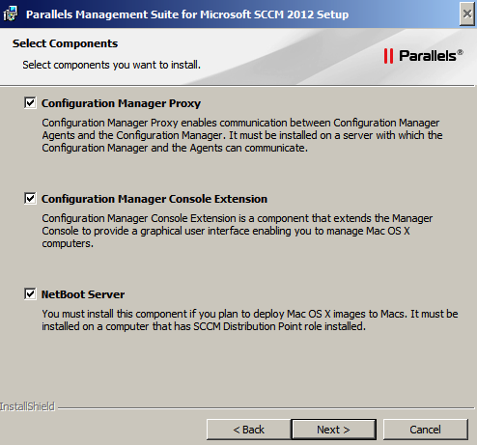
Components
Parallels Management Suite consists of four major components:
Mac Agent
SCCM Proxy
SCCM Console Extension
NetBoot Service
Notes:
Mac Agent – executes management commands
SCCM Proxy – integrates Mac agents with SCCM
SCCM Console Extension – enables Mac management from the manager console

Slide 11
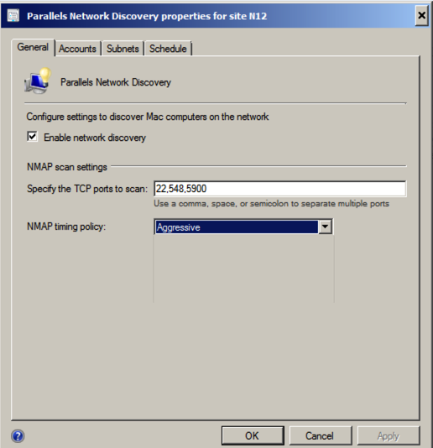
Scheduled Discovery Procedure
Searches Macs in network
Tries to establish SSH connection
Installs agents to Macs
Adds Macs to SCCM
Notes:
Searches Macs in network
Subnets to be specified to search in
Tries to establish SSH connection
Remote login (SSH) to be enabled on Macs
Installs agents to Macs
Needs administrative rights on Mac
Either Mac should be enrolled in corporate domain
Or administrative user account should exist on Mac
Adds Macs to SCCM
Located in the dedicated collection
Allowing admins to manage them

Slide 12
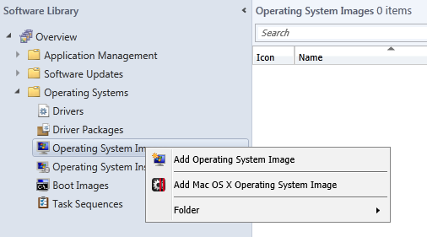
Deploy Mac OS images
Enhance existing WDS/PXE setup to support Net boot
Deep integration into SCCM console and Distribution Points
No separate infrastructure needed
No separate GUI/Windows
Software enhances Distribution Points to support Netboot
Use Mac OS standard images

Slide 13
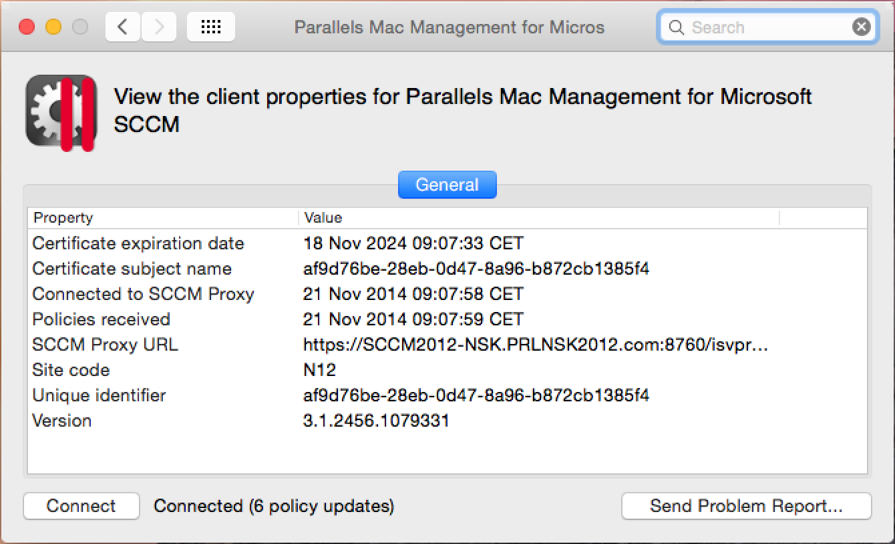
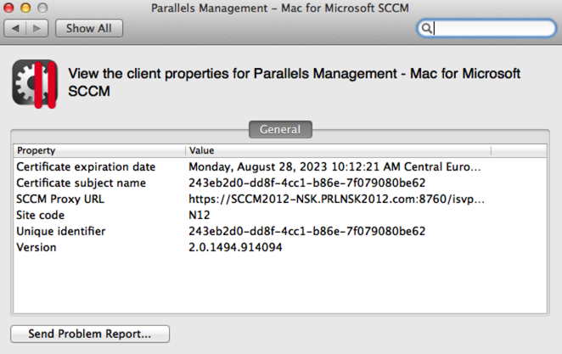
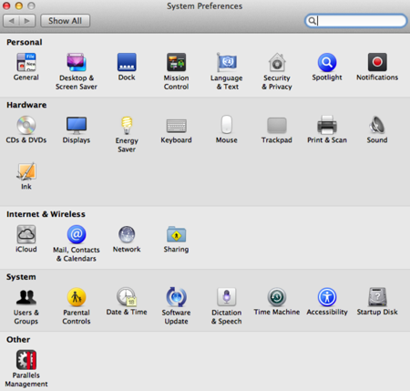
Mac client widget
Check PMM/SCCM client properties
Send problem report to Parallels
Notes:
Administrators almost always want to know which Macs exist in the network but is not managed yet.
Scheduled Network Discovery provides this ability by searching Macs in the network and adding found Macs as a resources to SCCM.
It also tries to make those Macs managed by installing agents to them, but it requires the access rights to do that, so Macs should be prepared.

Slide 14
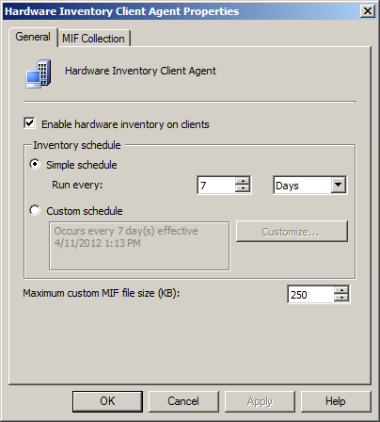
Inventory
Inventory information is gathered from Macs
When Macs are added to SCCM
Later, according to inventory schedule
Accessible in standard SCCM Resource Explorer
Inventory data is used for:
Tracking hardware & software assets
Generating reports
Defining specific Mac collections to be managed
Notes:
When a Mac is first time added to SCCM, the Agent reports inventory information to SCCM.
Later it continues reporting inventory information by the schedule set for all resources in SCCM.
This inventory inventory information is a subset of data normally collected from Windows computers.
And it can bee seen in the standard SCCM Resource Explorer, as well as it can be used to generate custom reports about Macs.

Slide 15
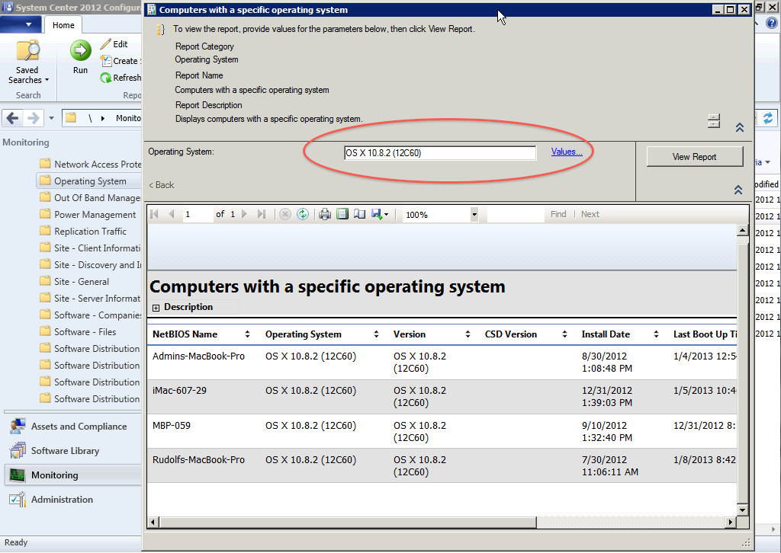
Reports: Operating Systems
Notes:
OSX-Client-Daten integrieren sich in die Standard-Reports

Slide 16
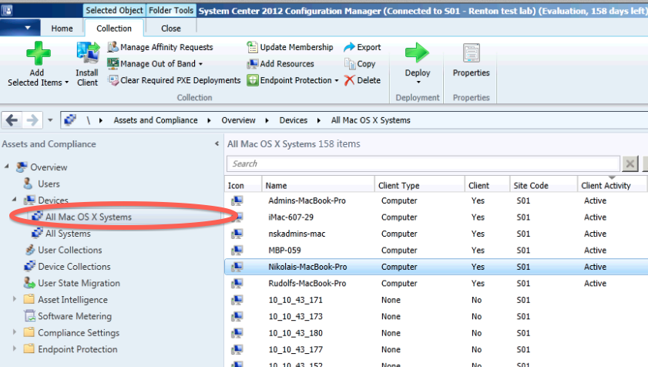
New OS X Device Collection

Slide 17
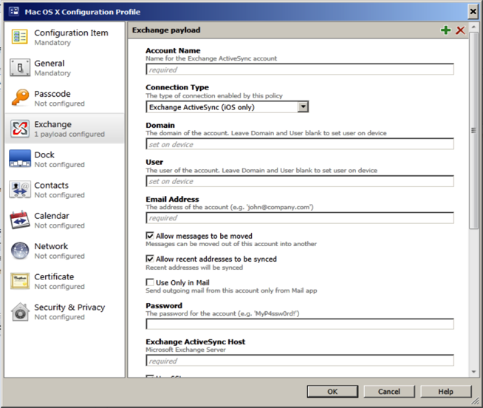
Managing Mac OS X Preferences
Configure Macs using Mac OS X Configuration Profiles
Configuration Profiles are delivered via Desired Configuration Management functionality of SCCM
Notes:
Similarly, Macs will be set up using Mac OS X configuration profiles. Configuration profiles will be delivered via Configuration Management functionality of SCCM
Momentan Profilemanager OSX nötig, später nicht mehr

Slide 18
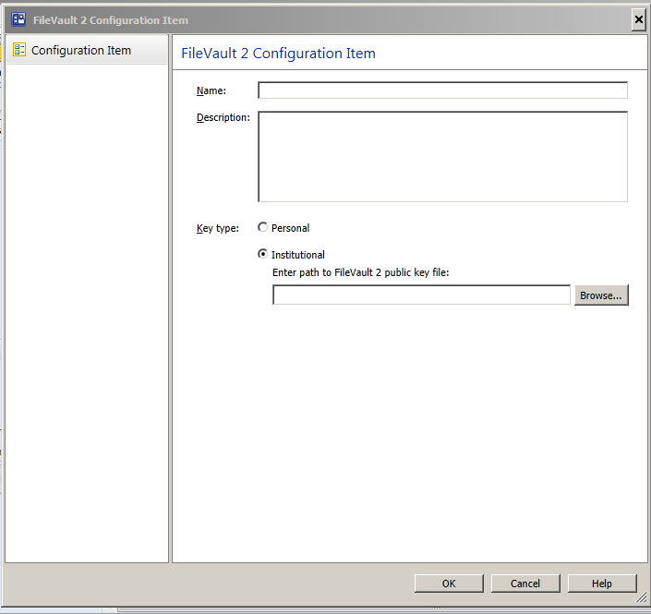
FileVault
Configure Mac OS X FileVault
Institutional Key
Personal Key
Central store on SCCM SQL Server
Recover keys via Management Console
Notes:
Similarly, Macs will be set up using Mac OS X configuration profiles. Configuration profiles will be delivered via Configuration Management functionality of SCCM
Momentan Profilemanager OSX nötig, später nicht mehr

Slide 19
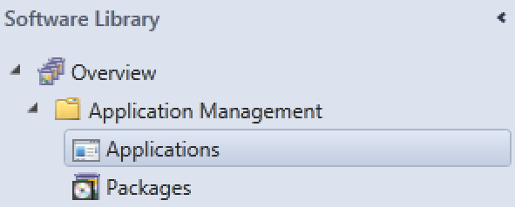

Software Deployment
Application Management can be done by using both supported methods
Applications
Offer Application Catalog to Mac users
Easy to use free conversion utility
http://www.flaschengeist-studios.com/cmapputil-helper
Packages
Quick & easy deployment
Native OS X package format

Slide 20
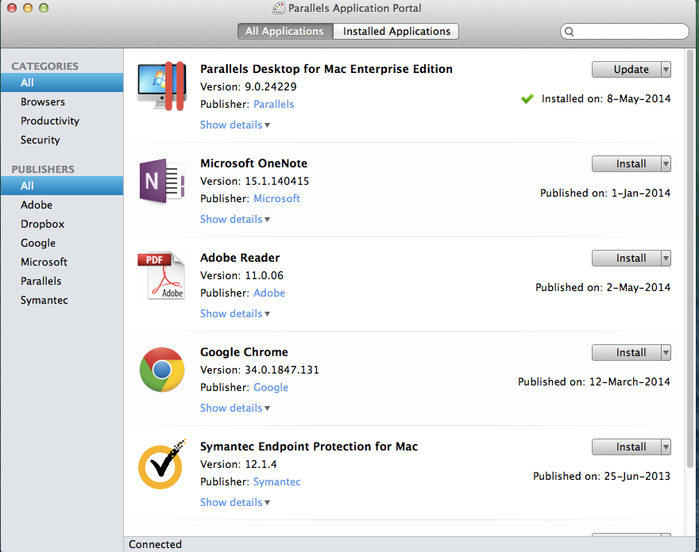
Application Self-Service Portal

Slide 21












Corporate Applications
Top Programs used in Parallels Desktop today
Out of more than 1 million reports, there are more than 10,000 discrete Windows apps being used in Parallels Desktop today
The Top 10
Internet Explorer
Windows Media Player
Notepad
Firefox
Google Chrome
Microsoft Word
Microsoft Excel
Adobe Reader
Microsoft Paint
Remote desktop connection
Notes:
IE
Peachtree
Quickbooks
Visual Studio

Slide 22
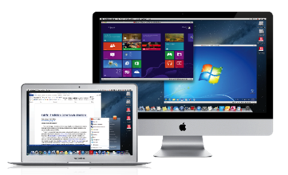
Parallels Desktop® for Mac
Enterprise Edition
The simplest, easiest way to bring Windows stack and applications
to employees with Macs
Benefits include:
Unified product activation key
Free upgrades to new versions
24/7 priority phone and email support
Mass deployment tools
Can be managed by Parallels Mac Management for Microsoft SCCM
Prevents users from changing settings
Create expiring virtual machines

Slide 23
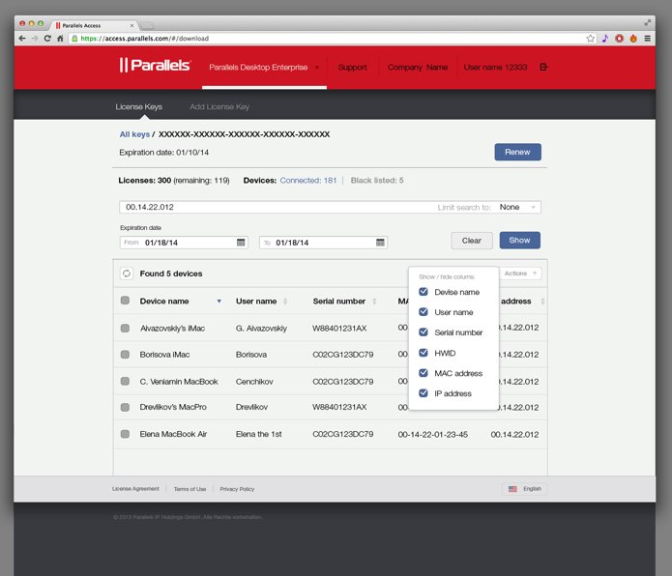
Licensing Portal
The IT administrator can manage the individual seats for the Enterprise Edition via a web portal.

Slide 24
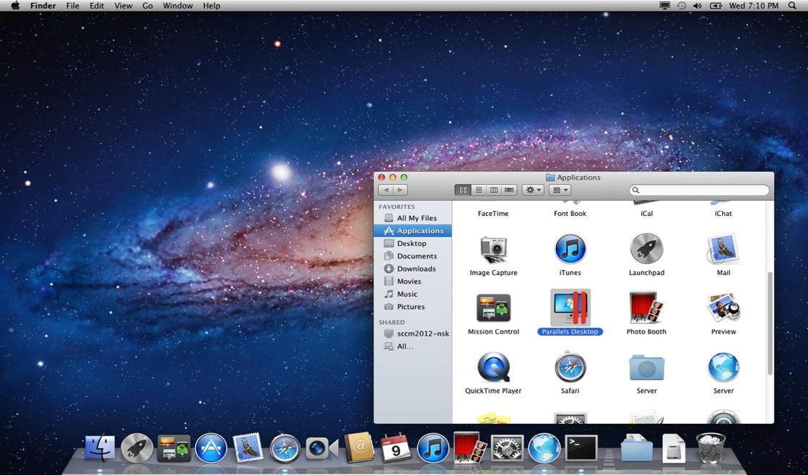
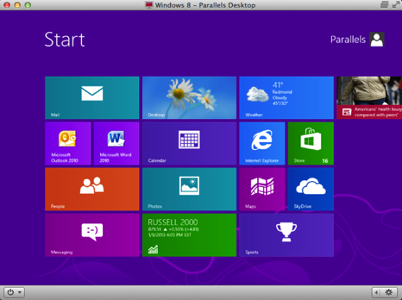
Mac After Parallels Desktop Package Deployment

Slide 25
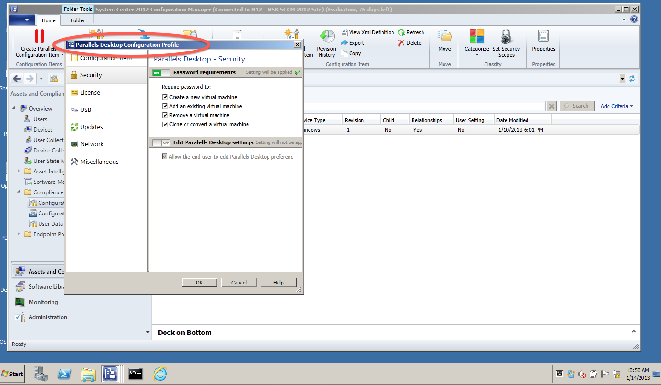
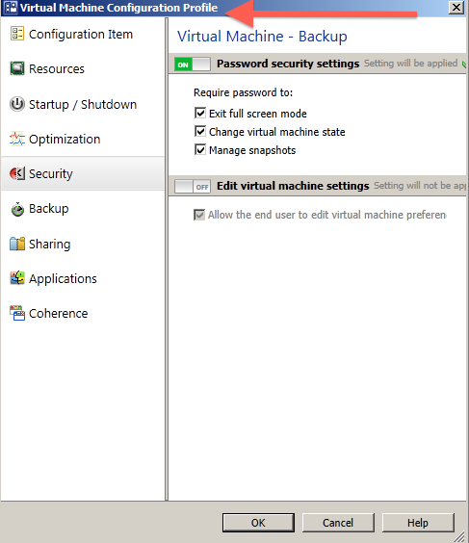
Managing Parallels Desktop & Virtual Machine Settings

Slide 26
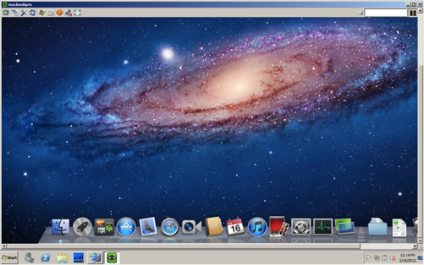
Remote Access: VNC
Screen sharing via VNC allows to control the logged user’s screen
Admin don’t have to provide a password to establish VNC connection to managed Mac
When session is closed, all changes are rolled back to keep security intact
Notes:
PMA will allow an administrator to take a remote control of managed Macs via VNC, which is similar to Remote Desktop on Windows or SSH. In case of VNC an admin doesn’t have to provide a password to establish a connection. Our software takes care of the automatic and secure login.

Slide 27
Parallels Mac Management vs. SCCM 2012 R2
 | PMM | SCCM 2012 R2
Support for Mac OS X 10.10 |  | 
Network discovery and automatic enrollment |  | 
Manual enrollment |  | 
Hardware and software inventory |  | 
Show warranty status |  | 
Self-Service Application Portal for Macs |  | 
Deploy software packages | 
Deploy Mac OS X Configuration Profiles |  | 
Easy to use OS X Configuration Profile editor |  | 
Push scripts as SCCM Configuration Items |  | 
Deploy Mac OS X pre-built images |  | 
Enable FileVault 2 encryption |  | 
Remote Assistance |  | 
Notes:
Values market with * are coming in PMM v3.0

Slide 28
SLALOM CONSULTING
Notes:
We’re happy to have one of our customers here today to talk about their environment and how Parallels Mac Management is helping them to deploy and manage Macs in their business. Dan Yurcovic is …NEED BIO INFO

Slide 29

Slalom - 2015
Customer Point of View – Slalom Consulting
SEATTLE
PORTLAND
MINNEAPOLIS
BOSTON
HARTFORD
CHICAGO
NEW YORK
LONDON
SAN FRANCISCO
DENVER
SILICON VALLEY
SOUTHERN CALIFORNIA
PHOENIX
A business and technology consulting firm with:
more than 3000+ employees
16 offices in North America and London
120+ employees in Corporate Services
$640M+ in revenue
DALLAS
ATLANTA
HOUSTON
Notes:
Today – we are doing pretty well.
Who is taking claim for that? Well, IT and Operations of course! How did they help us get here?
What stayed the same? Our systems are the same.

Slide 30
Customer Point of View – Slalom Consulting
Problem Slalom faced
Primarily a Microsoft shop
No primary infrastructure to deploy or manage Macs
Outgrew current Mac Imaging solution
2011: 100+ Mac clients
2014: 400+ Mac clients
Solutions Evaluated
Native Mac Backup/restore (Time Machine)
SCCM 2012 Native Mac Management
JAMF Imaging

Slide 31
Customer Point of View – Slalom Consulting
Why Parallels?
SCCM native support lacked OSD, overly complicated to configure/manage and felt very v1
Parallels Mac Management provides excellent SCCM integration
Much more than a plug-in, it leveraged the SCCM technical model
Streamlined management and deployments at all SCCM sites
Automation for customizing the Mac environment
Deployment Experience
Very similar to SCCM (Windows)
Simple and quick “Capture” process for image
Distribution management through SCCM DP’s
Easy for non-technical users to initiate network boot based deployment
Fast

Slide 32

Notes:
Adam has loved tech since his first game of Pac-Man. IT Manager for the UW-Oshkosh Bookstore is where the IT path started; the realization that there is always a need for those skilled in filling the gap between technology and it’s users. Over the past 18 years Adam has parlayed his skill in this area into many leadership roles spanning much of what the Silicon Valley is known for, from leading global IT Support and Infrastructure services at Yahoo! to running IT for the exciting startup Lytro. Let’s listen to how he’s utilizing Parallels Desktop Enterprise at Lytro…

Slide 33
Questions?

